Slide 1
Mayday!!!
Bleed Trails. Why. What they are. How to make them go away.
Baillie Duncan

Slide 2
Why?
Why do we have the problem of bleed trails?
Bleed trails are the result of taking an exposure with a CCD (Charged-Coupled Device) that was too long for the object being imaged. An over exposure causes the electrons to “spill over” and create the appearance of a bright streak on the final image.
http://giphy.com/gifs/rmRDNnH9rW3wQ
Source: GIPHY.com

Slide 3
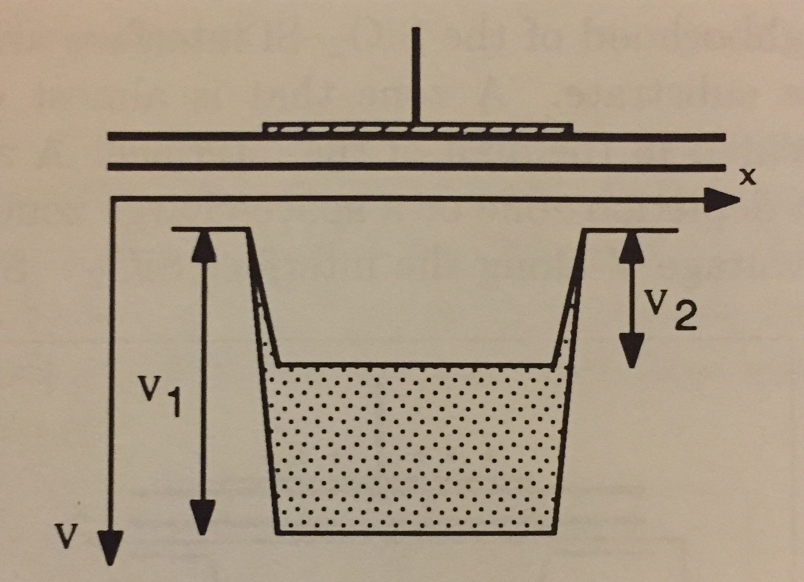
What are Bleed Trails?
First, we must know a little bit about how the CCD works to understand what bleed trails are exactly.
The charges are stored in whats called a Voltage Well. (V in the diagram) This Well typically is 3-6 micrometers in depth from the silicon-oxide interface. (X in the diagram, but not the main focus here.)
Thermal Relaxation Time is when there are equal amount of electrons on the surface as there are holes in the Voltage Well.
*** Useful electrons can only be gathered into the Voltage Well for a time period less than the Relaxation Time!
Side Note: The reason you must cool down the CCD so much, is so the Relaxation Time will last for several hours. We need the Relaxation Time to last that long because the production of charges by photoelectric effect can last several hours. The Relaxation Time must be longer than the the time you are gathering your data.
Source: “CCD Astronomy” by Christian Buil

Slide 4
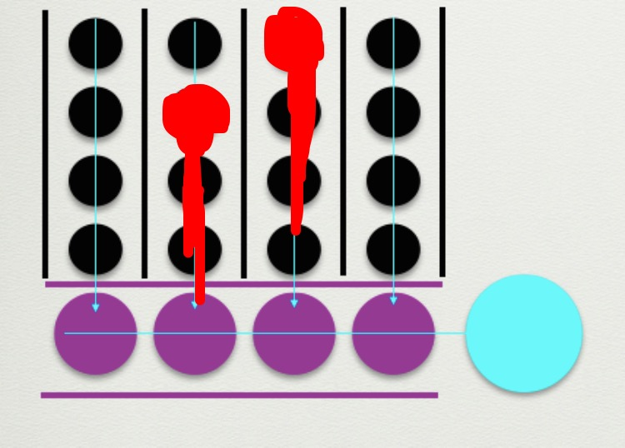
What are Bleed Trails?
SO……
Bleed Trails happen when the exposure time was GREATER than the relaxation time.
- In other words, there were too many charges and not enough holes in the Voltage Well to store them, which is the cause of the spilling over of charges.
Bleed Trails will also ALWAYS be vertical.
The charges will never cross the black lines.
Source: “CCD Astronomy” by Christian Buil

Slide 5
Ten Second Exposure

Slide 6
How can we get rid of them?
PROBLEMS:
- Bleed trails can hide other objects nearby that may be important.
- Bleed trails could be mistaken for part of the object if they are small.
- Taking many images with bleed trails can damage the CCD and make “ghost pixels” permanent.
Solution: Retake the image.
- Before you reset your exposure time and take a bunch of images of your object, you must clear out the CCD.
- Think of setting the table for an important dinner. After setting it up, you accidentally spill water on the table, and you must clean up all of the water before you reset the table. If you left the water, the table would just look messy and not right.
- The charge that has “spilt” out of the Voltage Well needs to be cleaned up in order for you to have a clear accurate picture.
- This is done by taking DARK frames many times until you no longer see a “ghost image” (pixels that are captured by the CCD because it has some leftover charge).
Source: http://adsabs.harvard.edu/abs/2008AJ....136.2136R

Slide 7
Project Results
One Second Exposure
Ten Second Exposure
Five Second Exposure

Slide 8
The purpose of my project was to find out the reasoning behind the mistake of a bleed trial in order to inform future students of this class on what went wrong, why, and how to fix it in.
This project could also be the beginning of many projects to identify and solve mistakes. Eventually, it would become a “Mayday Manual” for the future students of this class.

